Slide 1

Deepfake Audio Detection in Call Centers
Conceptual Framework Using Spectral and Temporal Analysis
Muaz Abdullahi
Bilaminu Ishola
Hamzah Elnour
Md. Shakil Hossain
Ajmal Hamidi
Supervisor: Dr. Mahfoudh Saeed Ali Mohammed
Master of Science in Information Technology | College of Computer | Qassim University | Kingdom of Saudi Arabia

Slide 2
Presentation Outline
01
Introduction & Problem Statement
Background, motivation, objectives, and research questions
02
Literature Review
Traditional forecasting methods, ML approaches, and BI frameworks
03
Methodology
ETL pipeline, star schema data warehouse, feature engineering & ML models
04
Implementation & Experimental Setup
Model performance — Linear Regression, Random Forest & XGBoost comparison
05
Conclusion & Future Work
Key findings, study limitations, and recommended next steps

Slide 3
The Deepfake Audio Threat
Generative AI now produces highly realistic synthetic speech, exposing voice authentication in call centers to three attack types:
Text-to-Speech (TTS)
Voice Conversion (VC)
Generates artificial speech from text using models like Tacotron + WaveNet, mimicking target voices without the attacker speaking.
Transforms an attacker's live speech to sound like a target speaker while preserving linguistic content — dangerous in real-time calls.
Model Evaluation
Replay Attacks
🛠 Tools & Technologies
Replays pre-recorded genuine speech to bypass authentication; may include channel distortions from recording and playback.

Slide 4
Problem Statement
Generalization Deficit
Real-Time Constraints
Performance degrades on unseen synthesis techniques and telephony distortions.
High-accuracy models fail to meet strict latency requirements for live call authentication.
Environmental Robustness
Integration Complexity
Codec compression, packet loss, and background noise obscure synthetic speech artifacts.
Most systems lack APIs or microservices for IVR, CRM, and fraud pipeline integration.

Slide 5
Research Questions
Research Questions
RQ1: Limitations of existing detection in call centers?
1
RQ2: How to combine spectral and temporal analysis?
2
RQ3: Which features best identify voice spoofing?
3
RQ4: How to design for real-time detection?
4
RQ5: How to ensure robustness against distortions and emerging techniques?
5

Slide 6
Objectives
Objectives
Review existing detection techniques and limitations
1
Examine spectral and temporal feature extraction methods
2
Design a unified spectral-temporal conceptual framework
3
Define key components and processes
4
Evaluate real-time telephony support
5
Propose robustness strategies against evolving deepfakes
6

Slide 7
Literature Review: Key Findings
Study | Actual Sales | Dataset | Result | Key Limitation
Shahzad et al. [21] | VGGish-LSTM | ASVspoof 2019 LA | 99.11% Acc; EER 1.18% | Dataset dependency; overfitting
Verma et al. [22] | SE-1D CNN | ASVspoof 2019 | 97.64% Acc | High cost; limited accents
Kwak et al. [24] | ResMax | ASVspoof 2019 | EER 0.37% (PA) | CQT-only; no temporal modeling
Chugh et al. [26] | VGG16/VGG19 | Audio-visual | 99.96% (STFT) | ~138M params; no dropout
Malik & Changalvala [29] | Custom CNN | 248 images | 100% Acc | Tiny dataset; poor generalizability
Research Gap
No existing system combines spectral-temporal fusion, telephony robustness, real-time deployment, and continuous learning.

Slide 8
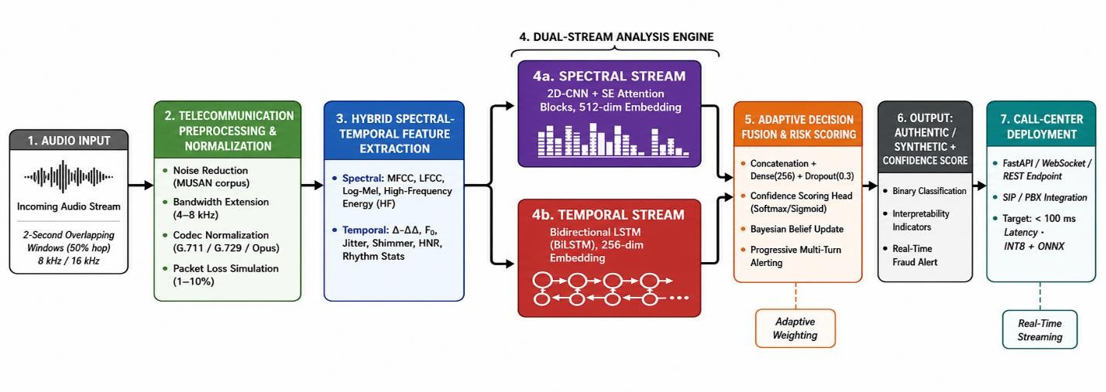
Proposed Conceptual Framework

Slide 9
Dual-Stream Analysis Engine
Spectral Stream —
2D-CNN + SE Attention
Temporal Stream — BiLSTM
Fusion & Classification
Processes log-mel spectrograms (128 bins) with four convolutional blocks and Squeeze-and-Excitation attention. Detects irregular harmonics, spectral smoothing, and vocoder artifacts. Outputs a 512-dimensional spectral embedding.
Two stacked BiLSTM layers (128 hidden units per direction) model long-range prosodic dependencies — rhythm, timing consistency, and articulation transitions. Outputs a 256-dimensional temporal embedding.
Concatenated embeddings pass through a dense fusion layer (256 neurons, dropout 0.3) with softmax binary classification. Bayesian belief updating enables progressive multi-turn fraud alerting.

Slide 10
Implementation & Experimental Setup
Development Stack
Datasets
Python 3.10+ · TensorFlow 2.15 / PyTorch 2.1 · Librosa · FFmpeg · ONNX Runtime · FastAPI
ASVspoof 2019 (LA & PA) + ASVspoof 2021. Telephony degradation: G.711/G.729/Opus codecs, MUSAN noise at 5–20 dB SNR, 1–10% packet loss.
Training Config
Key Metrics
AdamW optimizer · Focal Loss (γ=2.0) · Cosine annealing · 5-fold cross-validation · Up to 50 epochs with early stopping
Accuracy, Precision, Recall, F1-Score, EER, t-DCF, Processing Latency (target <100 ms), Model Footprint

Slide 11
Comparative Evaluation
Criterion | Proposed | Shahzad [21] | Kwak [24] | Chugh [26]
Spectral-Temporal Fusion | ✓✓ Dual-stream CNN-LSTM | ✓✓ VGGish-LSTM | ✗ CQT only | ✗ Spectrogram only
Telephony Preprocessing | ✓✓ Codec + packet loss + noise | ✗ Clean audio only | ✗ Clean audio only | ✗ Clean audio only
Real-Time Latency | ✓✓ Target <100 ms, INT8 | ✗ Offline only | ✓✓ 286K params | ✗ ~138M params
Progressive Scoring | ✓✓ Bayesian belief update | ✗ Frame-level only | ✗ Frame-level only | ✗ Frame-level only
Deployment Architecture | ✓✓ FastAPI + SIP/PBX | ✗ Lab prototype | ✓ Edge-suitable | ✗ Lab prototype
Multi-dimensional comparison across 12 criteria vs. nine benchmarked systems. Scale: ✓✓ Strong · ✓ Moderate · ✗ Weak/Absent.

Slide 12
Conclusion
Key Contributions
Limitations
Six-module call-center framework
Conceptual design — not yet empirically validated
1
1
Hybrid spectral-temporal features
ASVspoof datasets may not reflect full call-center diversity
2
2
CNN + BiLSTM dual-stream
Audio-only (no multimodal biometrics)
3
3
Adaptive Bayesian fusion
Requires continuous updates as deepfake techniques evolve
4
4
Sub-100 ms deployment-ready architecture
5

Slide 13
Future Work
01
Full implementation and real call-center deployment
02
Integrate Wav2Vec 2.0, HuBERT, WavLM
03
Multilingual and multi-accent testing
04
Explainable AI (SHAP/LIME)
05
Adversarial robustness evaluation

Slide 14

Thank You — Questions Welcome

